Slide 1
SPE-210769-MS Applying Data Analytics and Machine Learning Methods for Recovery Factor Prediction and Uncertainty Modelling
Abel Thomas-Hy, ERCE Australia
Kanna Swaminathan, ERCE Singapore
Munish Kumar, ERCE Singapore
Aizat Rusli, ERCE Malaysia

Slide 2
Motivation
Recovery Factor (RF) is one the most critical, and sometimes subjective, inputs towards determine field reserve → no clear approach to calculate or estimate given the variety of factors governing its value
Estimating Reserves
Analogs
Early Field Life
Volumetric
Early to Mid Field Life
Material Balance
Decline Curve Analysis
Mid to Late Field Life
Numerical Reservoir Simulation
Mid to Late Field Life
Mid to Late Field Life
SPE-210769-MS • Applying Data Analytics and Machine Learning Methods for Recovery Factor Prediction and Uncertainty Modelling • Abel Thomas-Hy & Kanna Swaminathan

Slide 3
Can We Predict RF?
Develop a workflow to predict RF by applying machine learning (ML) and artificial intelligence (AI) methods
Use of Geological features
Use of Categorical features
Use of Numerical features
Apply a “low-code” ML approach that simplifies the ML workflow
Investigate and understand variables that can have an impact on Recovery Factor using ML and AI methods
Determine which parameters are of importance “to the machine” in RF prediction
Determine and rank the effectiveness of different algorithms
Understand some of the ML and AI solutions being developed in literature and industry
SPE-210769-MS • Applying Data Analytics and Machine Learning Methods for Recovery Factor Prediction and Uncertainty Modelling • Abel Thomas-Hy & Kanna Swaminathan

Slide 4












Machine Learning Approach
Data Collection
Data Preparation
Choose Learning Algorithm
Train the Model
Test the Model
Deployment/ Evaluation on a “Blind” Data Set
SPE-210769-MS • Applying Data Analytics and Machine Learning Methods for Recovery Factor Prediction and Uncertainty Modelling • Abel Thomas-Hy & Kanna Swaminathan

Slide 5
Data Sets
Machine learning models developed on two open-source reservoir datasets:
Tertiary Oil Recovery Information System (TORIS) database (1995 Vintage)
Reservoir database including ~2500 crude oil fields, onshore US
Representing ~65% of discovered oil onshore united states
TORIS database focuses primarily on ‘numeric’ inputs, rather than categoric such as geological feature
Inherent bias as many onshore US fields have similar development plans of tight well spacing and water injection
Gulf of Mexico (GOM) database
Collated by Bureau of Ocean Energy Management (US)
860 out of 1319 fields abandoned gives good certainty in recorded recovery factor
RF’s based on volumetric and performance based methods for remaining fields
Dominated by shelf and slope units
Majority of fields developed with water flooding
Dataset | Categorical columns | Numerical columns | Total Data Set Size | Total Number of Usable Data Points
TORIS | 14 | 56 | 96,670 | 9,336
GOM | 17 | 64 | 1,084,914 | 59,175
SPE-210769-MS • Applying Data Analytics and Machine Learning Methods for Recovery Factor Prediction and Uncertainty Modelling • Abel Thomas-Hy & Kanna Swaminathan

Slide 6
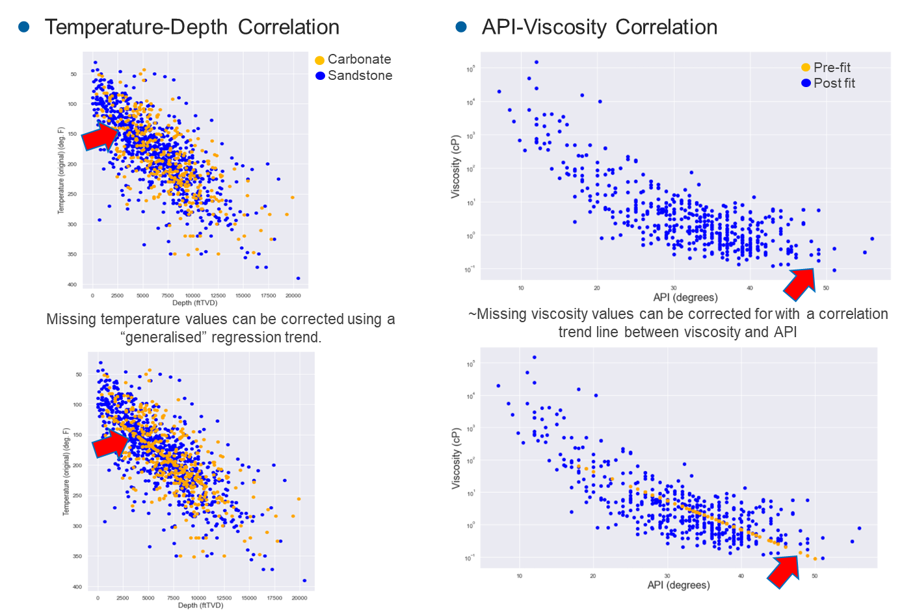
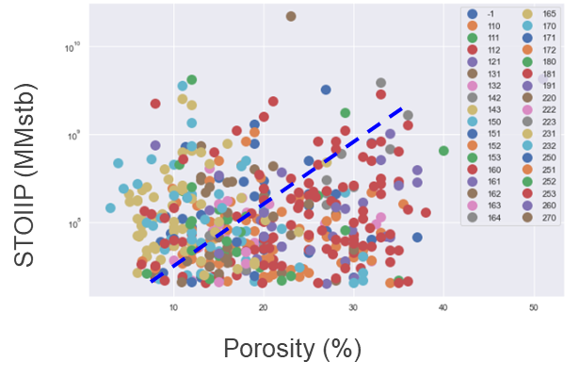
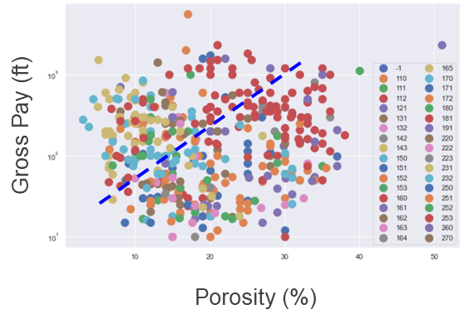
Domain Knowledge
Missing Values
Correlation ≠ Causality
SPE-210769-MS • Applying Data Analytics and Machine Learning Methods for Recovery Factor Prediction and Uncertainty Modelling • Abel Thomas-Hy & Kanna Swaminathan

Slide 7
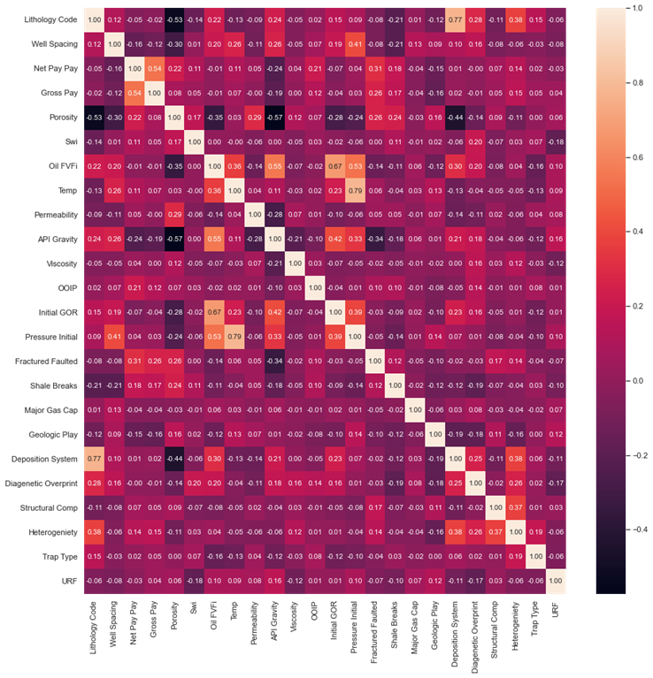
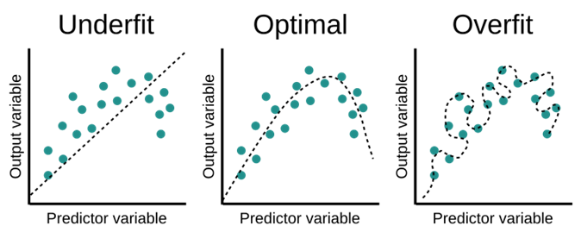
(Multi)collinearity
(Multi)collinearity is a condition where a predictor variable correlates with another predictor variable strongly. Therefore, changes in one of variable would cause changes in the other, giving a highly unstable end model.
Makes it difficult to determine which variables are significant if the model fluctuates greatly
Overfits your model because highly correlatable variables DOMINATE the output
Highly correlatable values defined as having coefficients > 0.7.
From the plot, the following 3 parameters show collinearity and do not add additional information to the predictive model.
Pressure → Temperature
Depositional System → Lithologic Code
Initial GOR → Oil FVFi
SPE-210769-MS • Applying Data Analytics and Machine Learning Methods for Recovery Factor Prediction and Uncertainty Modelling • Abel Thomas-Hy & Kanna Swaminathan

Slide 8
TORIS Database Inputs
 | count | mean | std | min | 0.25 percentile | 0.5 percentile- | 0.75 percentile- | max-
Lithology Code | 389 | - | - | - | - | - | - | -
Well Spacing | 389 | 36 | 48 | 1 | 10 | 20 | 40 | 640
Net Pay | 389 | 105 | 169 | 5 | 24 | 50 | 122 | 2300
Gross Pay | 389 | 266 | 356 | 10 | 50 | 150 | 300 | 2300
Porosity | 389 | 19 | 8 | 3 | 12 | 17.6 | 25 | 51
Swi | 389 | 31 | 10 | 10 | 25 | 30 | 36 | 68
Oil FVF | 389 | 1 | 0 | 1 | 1.099 | 1.2 | 1.33 | 2.127
Temp | 389 | 138 | 44 | 63 | 105 | 130 | 164 | 266
Permeability | 389 | 401 | 1507 | 0.1 | 10 | 52 | 300 | 26816.5
API Gravity | 389 | 32 | 9 | 6 | 27 | 34 | 38 | 52
Viscosity | 389 | 387 | 10468 | 0.07 | 0.81 | 2 | 7 | 200000
OOIP | 389 | 294 | 1210 | 21 | 48 | 884 | 210 | 22000
Initial GOR | 389 | 516 | 472 | 5 | 200 | 421 | 687 | 4000
Initial Pressure | 389 | 2215 | 1368 | 200 | 1250 | 1850 | 2900 | 9500
Fractured Faulted | 389 | 0 | 0 | 0 | 0 | 0 | 1 | 1
Shale Breaks | 389 | 1 | 0 | 0 | 0 | 1 | 1 | 1
Major Gas Cap | 389 | 0.5 | 0.25 | 0 | 0 | 0 | 1 | 1
Geological Play | 389 | 623 | 713 | 6 | 44 | 414 | 830 | 2417
Deposition System | 389 | 184 | 38 | 110 | 152 | 181 | 222 | 270
Diagenetic Overprint | 389 | 2 | 2 | 1 | 1 | 1 | 3 | 9
Structural Complexity | 389 | 14 | 9 | 10 | 10 | 10 | 10 | 50
Heterogeniety | 389 | 1 | 1 | 1 | 1 | 1 | 2 | 3
Trap Type | 389 | 2 | 1 | 1 | 2 | 2 | 3 | 3
URF | 389 | 0 | 0 | 0.024 | 0.25 | 0.311 | 0.4 | 0.5073
TORIS Database:
10 Categorical inputs (Lithology code, Fractured faulted etc.)
14 Numerical data types (Well spacing, net pay etc.)
9,336 datapoints (~10% of original database)
GOM Database:
2 Categorical inputs (Chronozone, Drive Mechanism)
13 Numerical data types
59,175 datapoints (~4% of original database)
SPE-210769-MS • Applying Data Analytics and Machine Learning Methods for Recovery Factor Prediction and Uncertainty Modelling • Abel Thomas-Hy & Kanna Swaminathan

Slide 9

How to chose right ML algorithm
Factors to consider:
Interpretability
The number of data points and features
Data format
Linearity of data
Training time
Prediction time
Memory requirements
→ Not an easy task.
An alternative is to build all and later select the best, but this is time consuming if done “manually”.
→ Low Code Machine Learning Libraries
SPE-210769-MS • Applying Data Analytics and Machine Learning Methods for Recovery Factor Prediction and Uncertainty Modelling • Abel Thomas-Hy & Kanna Swaminathan

Slide 10
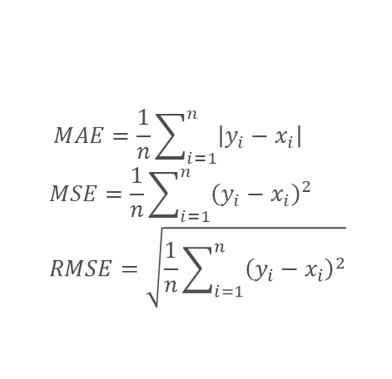
Running the ML algorithms
We apply a supervised learning approach, splitting the raw inputs into a train-validate-test set (70%-20%-10% split). The “train” set is used to build the model, and the “validate” set is used to test that the model works. We “test” the model using a totally new, never-before-seen data set.
A total of 20 models were tested as a first pass* using 10-fold cross validation; these models were ranked using the mean absolute error (MAE), the mean squared error (MSE) and the root mean squared error (RMSE).
Against outliers, the MSE and RMSE perform better
$$MAE=\frac{1}{n}\sum_{i=1}^{n}{\left|y_{i}−x_{i}\right|}$$
$$MSE=\frac{1}{n}\sum_{i=1}^{n}{{\left(y_{i}−x_{i}\right)}^{2}}$$
$$RMSE=\sqrt{\frac{1}{n}\sum_{i=1}^{n}{{\left(y_{i}−x_{i}\right)}^{2}}}$$
Where y_{i} is the prediction, x_{i} is the true value and n is the total number of data points.
Regressor Model (TORIS) | MAE | MSE | RMSE
Random Forest | 0.0791 | 0.0096 | 0.0976
Category Boost | 0.0821 | 0.0104 | 0.1015
K Neighbours | 0.0830 | 0.0109 | 0.1037
Regressor Model (GOM) | MAE | MSE | RMSE
Random Forest | 0.0790 | 0.0096 | 0.0978
Category Boost | 0.0708 | 0.0082 | 0.0906
K Neighbours | 0.1091 | 0.0179 | 0.1339
SPE-210769-MS • Applying Data Analytics and Machine Learning Methods for Recovery Factor Prediction and Uncertainty Modelling • Abel Thomas-Hy & Kanna Swaminathan

Slide 11
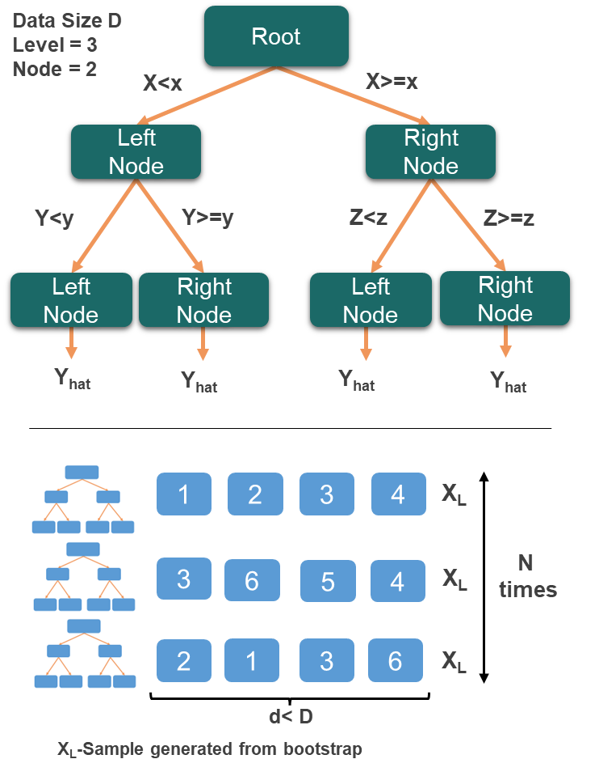
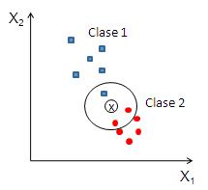
Differences in algorithms
RFR and CatBoost are linked to decision trees (DT)
DT can overfit; solution is to use an “bootstrapping” and “ensemble average”
CatBoost: Able to handle categorical as well as numeric data. Does this without requiring the conversion of categorical to dummy variables
RFR: Insensitive to outliers, works on large number of variables, hard to overfit, requires a lot of CPU memory.
KNN is a distance-based approach
Predicts based on how closely it matches the points of the training set
Distance methods – Euclidian, Manhattan (for continuous) and Hamming distance (for categorical).
SPE-210769-MS • Applying Data Analytics and Machine Learning Methods for Recovery Factor Prediction and Uncertainty Modelling • Abel Thomas-Hy & Kanna Swaminathan

Slide 12
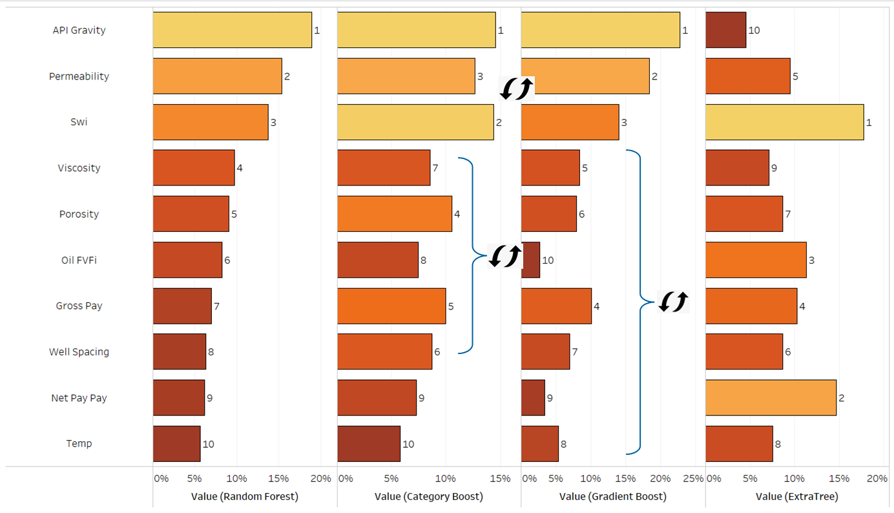
Top 10 Ranked Features
Some interesting observations for the ranking of the top 10 features:
API, permeability, Swi consistently ranked as among the top 3 important variables
The remaining variables change in importance ranking depending on the algorithm employed
Categorical data has smaller importance, likely due to large degree of categories leading to difficulties in establish trends
Extra tree ranking shows a completely different weighting to all the others
SPE-210769-MS • Applying Data Analytics and Machine Learning Methods for Recovery Factor Prediction and Uncertainty Modelling • Abel Thomas-Hy & Kanna Swaminathan

Slide 13
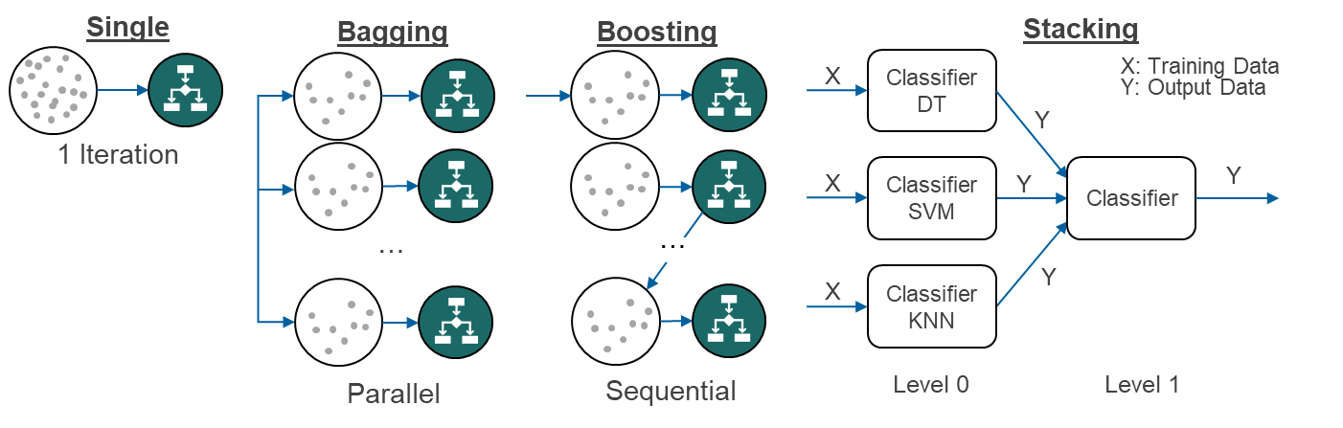
Combining Various ML techniques
Improving the predictive capability of ML an be done by “averaging” different interpreted models (Ensemble Modelling).
Bootstrap Aggregating (Bagging) – take (homogeneous) “weak learners” of the same type (same variables each time, but random subset), pass a prediction through each of them and average the result. Each “weak learner” is independent
Boosting – “Strong learner” = Weighted sum of (homogeneous) “weak learners” with higher importance given to models that were difficult to predict in the previous step.
Blending/ Stacking – combining different “weak learners” – i.e. multiple models are trained to predict the outcome and a meta-model is created that uses the predictions from those models as an input along with the original features.
SPE-210769-MS • Applying Data Analytics and Machine Learning Methods for Recovery Factor Prediction and Uncertainty Modelling • Abel Thomas-Hy & Kanna Swaminathan

Slide 14
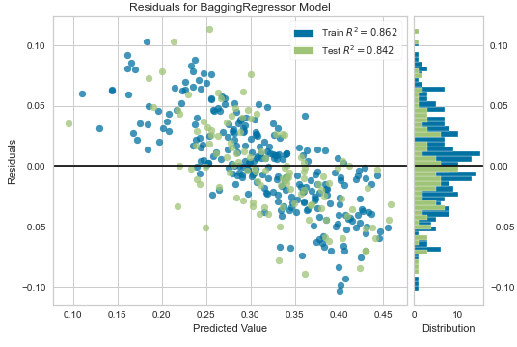
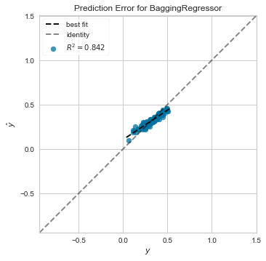
The optimal solution is a blend of all the tuned methods.
Regressor Model | MAE | MSE | RMSE
Pre- Hyper Parameter Tuning
RFR | 0.0791 | 0.0096 | 0.0976
CatBoost | 0.0821 | 0.0104 | 0.1015
KNN | 0.0830 | 0.0109 | 0.1037
Post- Hyper Parameter Tuning
Bagged knn | 0.0734 | 0.0082 | 0.0904
Blend 5 Soft | 0.0731 | 0.0084 | 0.0916
RFR | 0.0791 | 0.0096 | 0.0976
Bagged CatBoost | 0.0741 | 0.0087 | 0.0934
Parameters Tuned |  | Optimised Solution
Error Minimization | MAE, MSE, RMSE | RMSE
Iterations | 0-1000 | 50
Averaging | Bagging/ Boosting | Bagging
Search Algorithm | Random Grid Search, Bayesian, Optuna, Hyperopt | Random Grid Search
Blending? | True/ False | False
Stack | True/ False | False
K-folds | 5, 10, 15 | 10

Slide 15
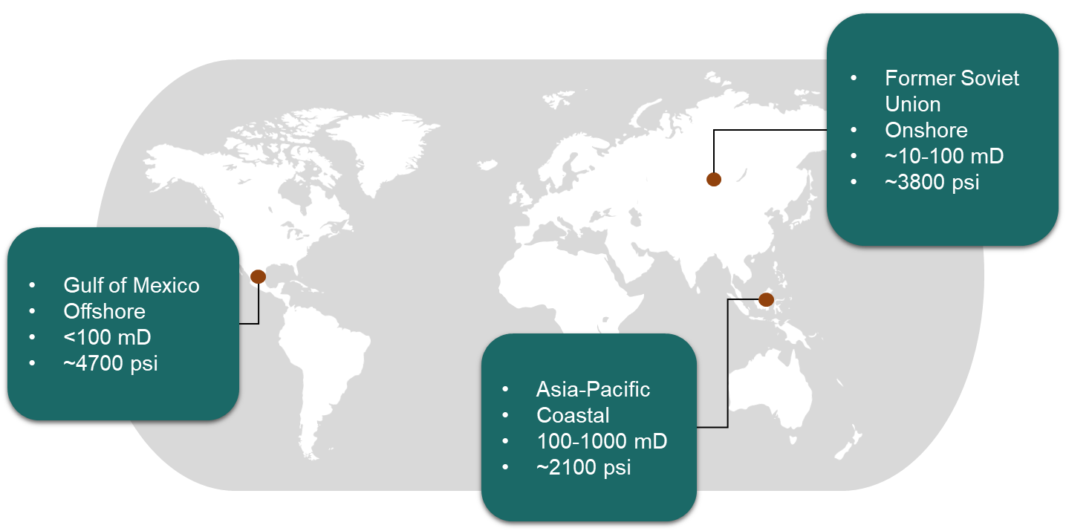
Deployment – Testing on a Blind Data Set
Machine learning models applied to ‘blind data set’ (hold-out set)
Blind dataset is 10% split of data which had been initially separated from training set
As a double-blind test - ERCE used data from 3 interpreted fields from locations around the world as a test in a ‘real world application’
SPE-210769-MS • Applying Data Analytics and Machine Learning Methods for Recovery Factor Prediction and Uncertainty Modelling • Abel Thomas-Hy & Kanna Swaminathan

Slide 16
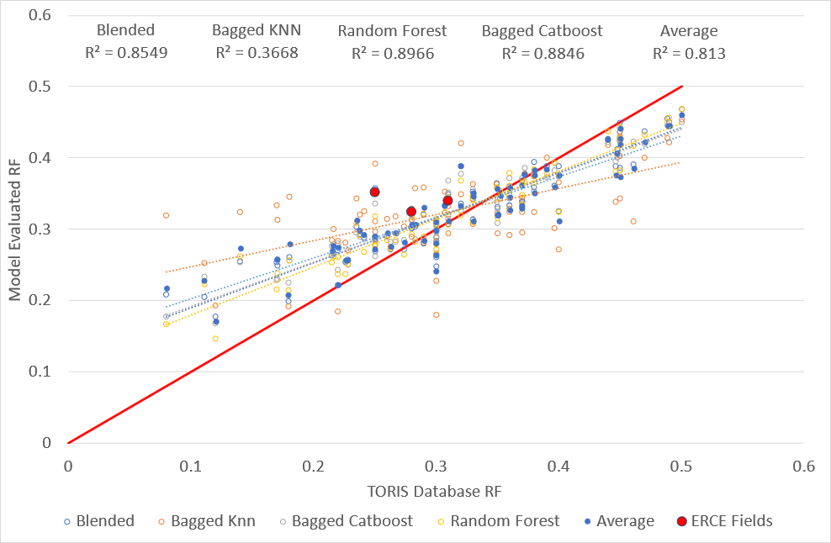
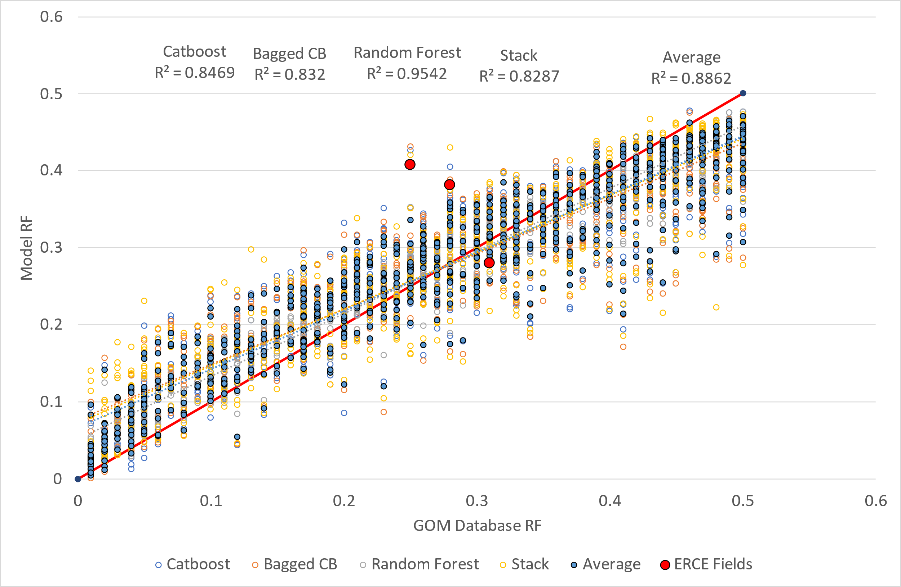
Results
TORIS
GOM
Field | Recovery Factor (V/V)
 | Independent Interpretation | TORIS ML Model | GOM ML Model
Former SU | 0.31 | 0.33 | 0.28
GOM Mexico | 0.28 | 0.32 | 0.38
Asia Pacific | 0.25 | 0.35 | 0.40
SPE-210769-MS • Applying Data Analytics and Machine Learning Methods for Recovery Factor Prediction and Uncertainty Modelling • Abel Thomas-Hy & Kanna Swaminathan

Slide 17
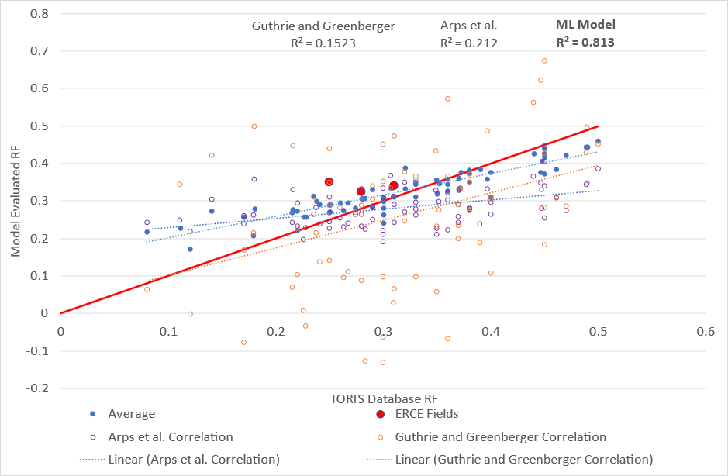
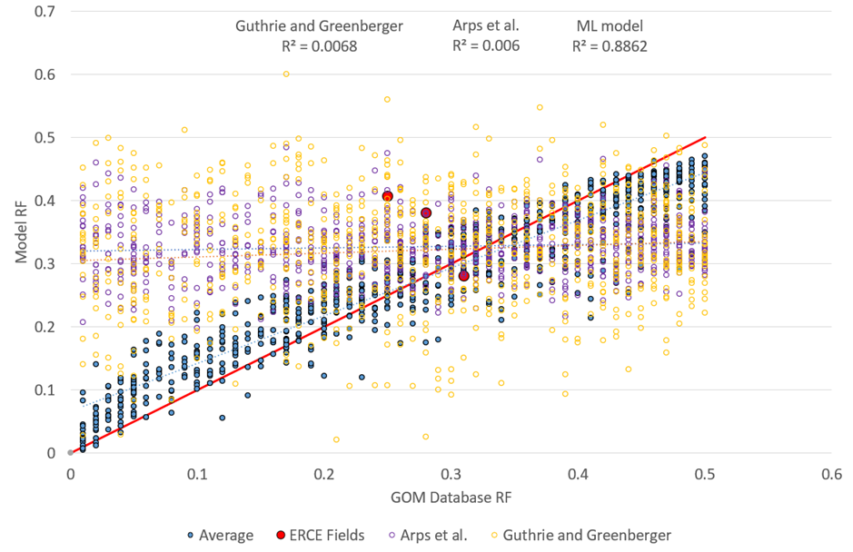
Results – Comparison to conventional correlations
TORIS
GOM
R² Value
ML Model | Arps et al. | Guthrie and Greenberger
0.81 | 0.21 | 0.15
R² Value
ML Model | Arps et al. | Guthrie and Greenberger
0.88 | 0.006 | 0.007
SPE-210769-MS • Applying Data Analytics and Machine Learning Methods for Recovery Factor Prediction and Uncertainty Modelling • Abel Thomas-Hy & Kanna Swaminathan

Slide 18
Conclusions and Learnings
Models provide basis for recovery factor prediction
Purpose of using the model must be considered
Margin of error (5-10%) shows a model suitable for early life RF estimation – in scenarios where analogues typically used
Must be used with caution in marginal fields where error margin can lead to erroneous decision making
Models are dependent on the quality of the data set
Model biased to the location of data set
Testing GOM model on fields ERCE evaluated in gulf of Mexico shows good results
Testing GOM model on fields in completely different location shows worse results
Model likely underestimates the effects of ‘categoric’ data compared to numerical data
Categoric data separated into too many individual categories – requires mores simplification for trends
Resultant likely underestimation of geological setting
Low code is an effective way to deploy machine learning – but uncertainty in process
Low code allows for rapid testing of multiple learning algorithms
Machine learning model built separately from low code environment shows similar results for one learning algorithm
Models show that machine learning can be effectively implemented to predict recovery given sufficient quality data set as long as domain knowledge respected
Further work in applying to larger – geographically spread data set
Use Neural Networks which are better at non-linearities
SPE-210769-MS • Applying Data Analytics and Machine Learning Methods for Recovery Factor Prediction and Uncertainty Modelling • Abel Thomas-Hy & Kanna Swaminathan

Slide 19
Acknowledgements / Thank You / Questions
-

